Slide 1
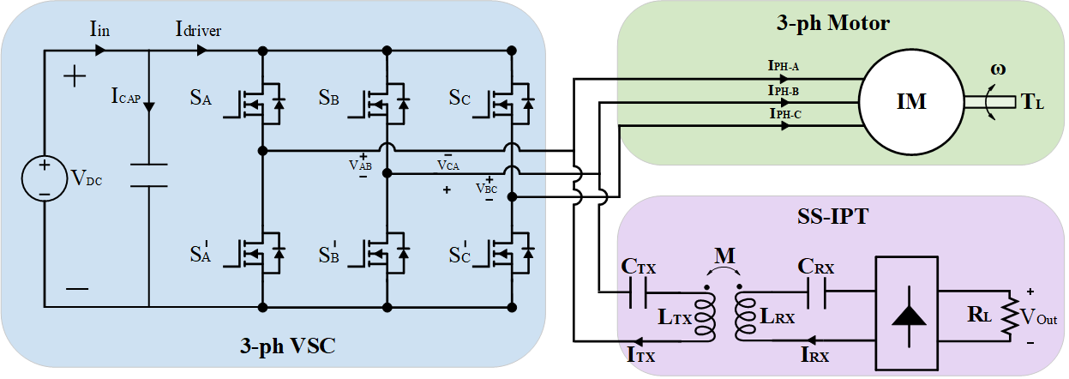
D:\Github\WPTMotor\Journal-3-phase\System Proposal\system_proposal_3VSC

Slide 2
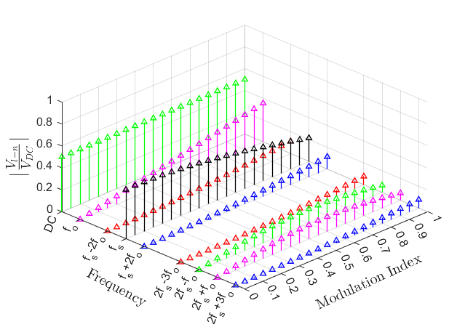
Fourier Series
D:\Github\WPTMotor\BLDC-whatever\fourier_series.m
The harmonic distribution of a line-to-neutral voltage among different modulation indices

Slide 3
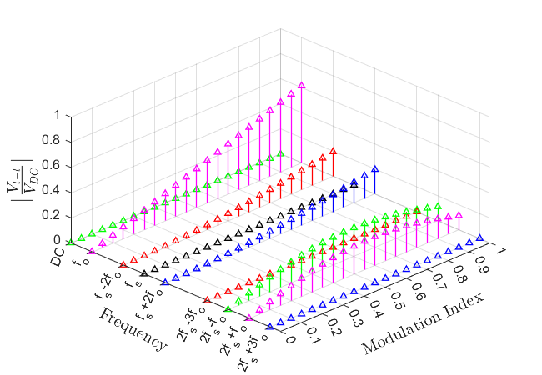
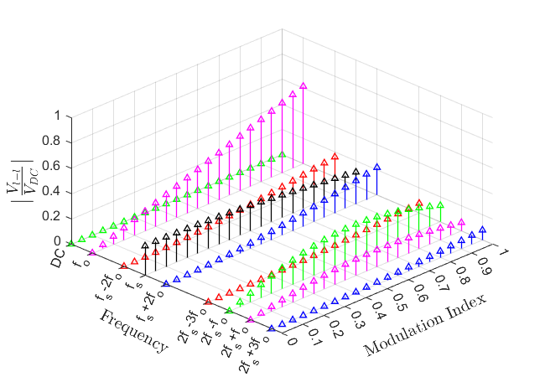
The harmonic distribution of a line-to-line voltage among different modulation indices without carrier phase shift
The harmonic distribution of a line-to-line voltage among different modulation indices with carrier phase shift ${30}^{o}$

Slide 4
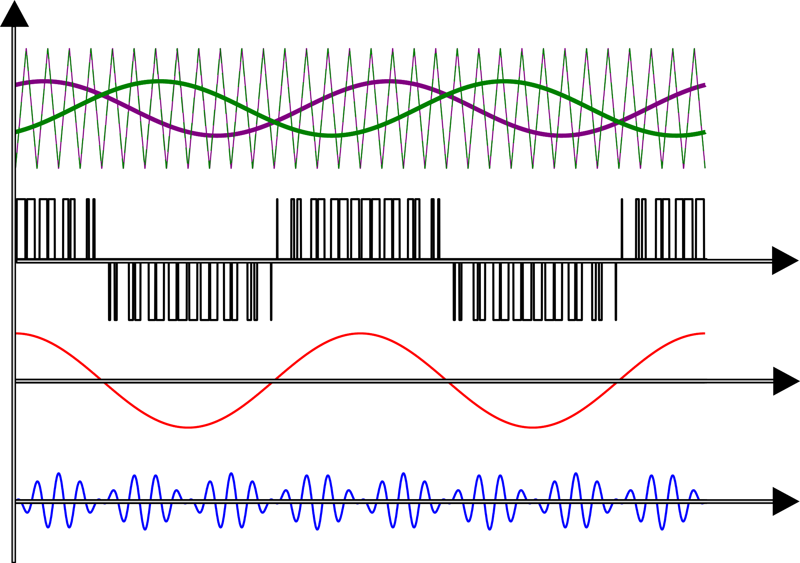
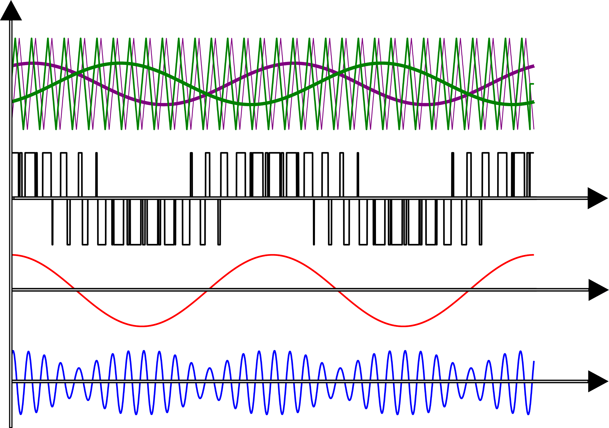
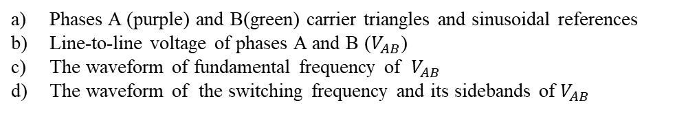
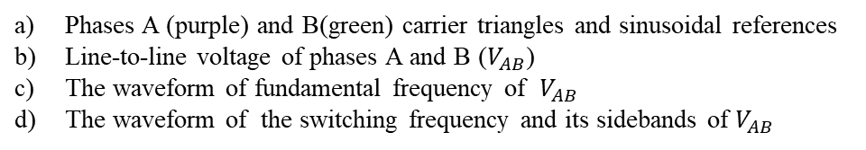
Key waveforms
D:\Github\WPTMotor\BLDC-whatever\time_domain.m
(a)
(a)
(b)
t
(b)
t
(c)
t
(c)
t
(d)
t
(d)
t
w/o carrier phase shift
w/ carrier phase shift
Phases A (purple) and B(green) carrier triangles and sinusoidal references
Line-to-line voltage of phases A and B ($V_{AB}$)
The waveform of fundamental frequency of $V_{AB}$
The waveform of the switching frequency and its sidebands of $V_{AB}$
Phases A (purple) and B(green) carrier triangles and sinusoidal references
Line-to-line voltage of phases A and B ($V_{AB}$)
The waveform of fundamental frequency of $V_{AB}$
The waveform of the switching frequency and its sidebands of $V_{AB}$

Slide 5
Carrier Phase Shift
D:\Github\WPTMotor\BLDC-whatever\control_space.m
Switching frequency of inverter normalized output voltage $| \frac{V_{AB}}{V_{DC}}|$
Fundamental frequency of inverter normalized output voltage $| \frac{V_{AB}}{V_{DC}}|$

Slide 6
Low sideband at switching frequency of inverter normalized output voltage $| \frac{V_{AB}}{V_{DC}}|$
High sideband at switching frequency of inverter normalized output voltage $| \frac{V_{AB}}{V_{DC}}|$

Slide 7
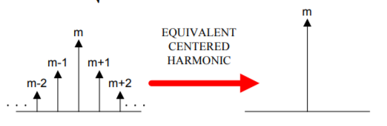
Equivalent centered harmonics approach
[1]
Switching frequency and its sidebands of inverter normalized output voltage $| \frac{V_{AB}}{V_{DC}}|$
[1] Analysis and Characterization of DC Bus Ripple Current of Two-Level Inverters Using The Equivalent Centered Harmonic Approach

Slide 8
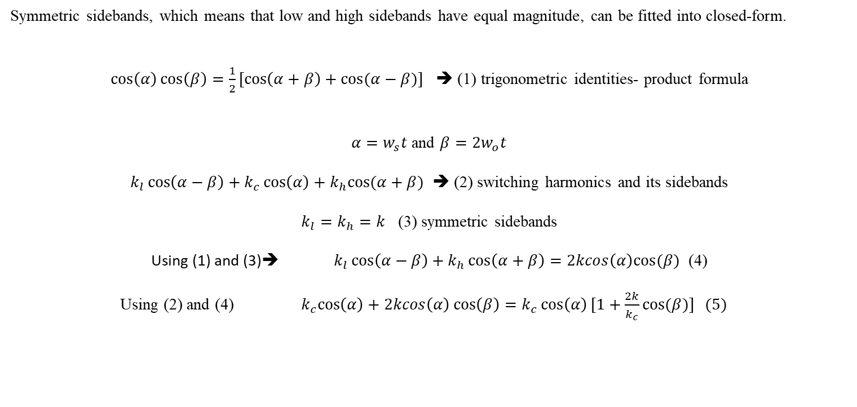
Rectification of switching frequency and its side bands
Symmetric sidebands, which means that low and high sidebands have equal magnitude, can be fitted into closed-form.
$\cos\left(α\right)\cos\left(β\right)=\frac{1}{2}[\cos\left(α+β\right)+cos⁡(α−β)]$ ➔ (1) trigonometric identities- product formula
$α=w_{s}t$ and ${β=2w}_{o}t$
$k_{l}\cos\left(α−β\right)+k_{c}\cos\left(α\right)+k_{h}cos⁡(α+β)$ ➔ (2) switching harmonics and its sidebands
$k_{l}=k_{h}=k$ (3) symmetric sidebands
Using (1) and (3)➔ $k_{l}\cos\left(α−β\right)+k_{h}\cos\left(α+β\right)=2kcos\left(α\right)cos⁡(β)$ (4)
Using (2) and (4) ${ k}_{c}\cos\left(α\right)+2kcos\left(α\right)\cos\left(β\right)=k_{c}\cos\left(α\right)[1+\frac{2k}{k_{c}}cos⁡(β)] (5)$

Slide 9
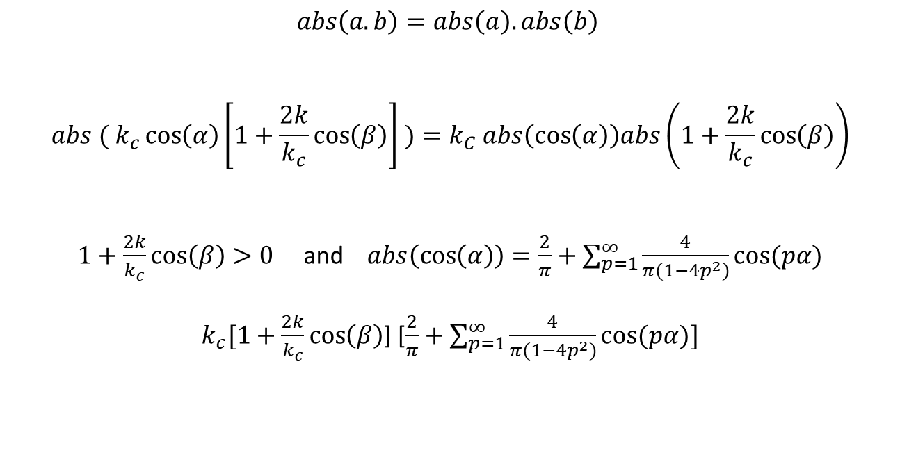
$$abs\left(a.b\right)=abs\left(a\right).abs\left(b\right)$$
$${abs ( k}_{c}\cos\left(α\right)\left[1+\frac{2k}{k_{c}}\cos\left(β\right)\right] )=k_{C} abs\left(\cos\left(α\right)\right)abs\left(1+\frac{2k}{k_{c}}\cos\left(β\right)\right)$$
$1+\frac{2k}{k_{c}}\cos\left(β\right)>0$ and $abs\left(\cos\left(α\right)\right)=\frac{2}{π}+\sum_{p=1}^{∞}{\frac{4}{π(1−{4p}^{2})}}cos⁡(pα)$
$k_{c}[1+\frac{2k}{k_{c}}\cos\left(β\right)$] [$\frac{2}{π}+\sum_{p=1}^{∞}{\frac{4}{π(1−{4p}^{2})}}cos⁡(pα)]$

